Slide 1
Online Travel Agency
Nakul PANT

Slide 2

Outline
Executive Summary
Introduction
Methodology
Visualizations and Observations
Conclusion

Slide 3
Executive Summary
Summary of methodologies:
Data Collection : As provided by stakeholders.
Data Wrangling : Using panda and Numpy in python.
Exploratory Data Analysis : With the help of Matplotlib, Seaborne and Spicy.

Slide 4
Outline
Summary of all results:
Data Collection Result : Data gathered in proper format with column names.
Data Cleaning Result : Removing all the discrepancies in the data.
Exploratory Data Analysis Result : Visualization and dashboard and screenshots.
Data Analysis : Providing observation and insights related to the data.

Slide 5
Introduction
Project background and context :
A leading online travel agency is looking to expand its market presence and enhance its revenue streams. To achieve this, the company aims to conduct an in-depth analysis of its data from the past six months to uncover key insights into sales, booking trends, and market dynamics. The objective is to leverage these insights to develop targeted strategies that boost sales, optimize pricing, and improve overall profitability.

Slide 6

Section 1 : Methodology

Slide 7
Data Inspection
DATA Snapshot
buyer_id | supplier_id | to_airport | from_airport | journey_type | pax | costprice | markup | selling_price | booking_date | payment_method
492 | 3 | CCU | ATL | round trip | 4 | 422.296189 | 92.13856571 | 537.4693961 | 3/1/2024 | PayPal
299 | 3 | HYD | HYD | round trip | 2 | 692.9818841 | 375.3632274 | 1162.185918 | 3/1/2024 | Credit Card
64 | 4 | BLR | SEA | one way | 3 | 797.7881489 | 404.7494663 | 1303.724982 | 3/1/2024 | Bank Transfer
345 | 6 | DEL | DEN | one way | 2 | 286.4728821 | 92.20224776 | 363.3080885 | 3/1/2024 | Credit Card
31 | 6 | DEL | BOM | one way | 4 | 840.5605813 | 173.5953428 | 1057.55476 | 3/1/2024 | Debit Card
1 | 7 | HYD | ORD | round trip | 2 | 649.568286 | 320.3561483 | 1050.013471 | 3/1/2024 | Debit Card
refund_status | refund_amount | channel_of_booking | booking_status | travel_date | cashback | coupon_redeem | Coupon USed?
Yes | 369.6489946 | Web | confirmed | 4/3/2024 | 5.374693961 | 0 | No
Yes | 799.3029172 | Web | confirmed | 14-05-2023 | 11.62185918 | 0 | No
Yes | 896.6475714 | Web | confirmed | 26-09-2023 | 0 | 0 | No
Yes | 249.8681239 | Android | confirmed | 17-10-2024 | 0 | 9.220224776 | Yes
Yes | 727.3419781 | Web | confirmed | 11/9/2023 | 0 | 0 | No
Yes | 722.155395 | Web | confirmed | 12/12/2024 | 0 | 32.03561483 | Yes

Slide 8
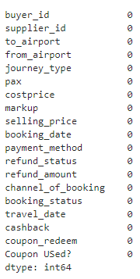
Data Inspection
We can clearly see that there are no null values in the data.
buyer_id represents unique customers.
supplier_id represents unique suppliers from whom flights were purchased for resale.

Slide 9
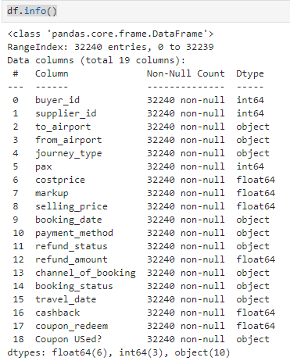
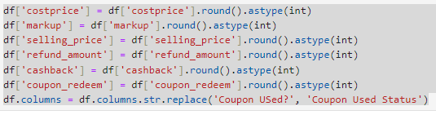
Data Wrangling: Snippet
We will convert some of the column datatype from float to int for better analysis
Considering PAX field as an abbreviation for passengers/no of passengers.
Will Change Coupon Used? Column to Coupon used status.

Slide 10


Section 2 : Insights Drawn from EDA

Slide 11
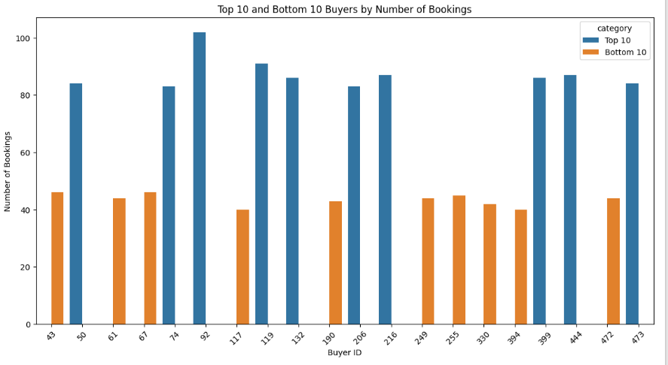
Top 10 and Bottom 10 Buyers

Slide 12
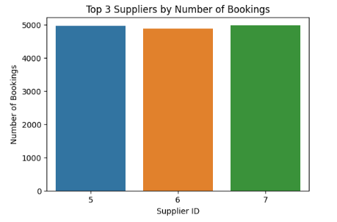
Top 3 Suppliers

Slide 13
Observations
We have identified top10 and bottom 10 buyers .
Out of those our premium buyer_id are:92,119,216etc.
While our bottom to buyer_id are: 117,394,330 etc.
We can clearly see that the top 3 supplier out of total supplier with ids: 5,6,7.

Slide 14
Causes and Strategies
Competitive Pricing: Company might be offering competitive prices that attract more customers compared to others.
Effective Partnerships: Suppliers could have partnerships with companies or platforms that drive traffic and bookings.
By addressing the specific needs and weaknesses of both top and bottom suppliers, you can improve overall sales and profitability while maintaining a competitive and diverse marketplace.

Slide 15
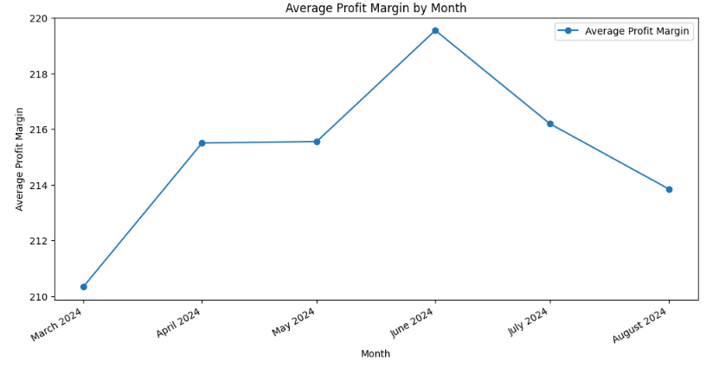
Month Wise Average Profit Margin

Slide 16
Causes and Strategies
It can be seen from the above line graph that the maximum profit margins are in the months of April may and June, this could be due to the summer holidays during this period. To capitalize on this pattern and improve sales and profitability throughout the year, consider the following strategies:
Dynamic Pricing: Implement dynamic pricing strategies to optimize revenue during high-demand periods. Adjust prices based on real-time demand, competition, and booking patterns.
Cross-Selling and Upselling: Suggest additional services or products (like travel insurance, premium services, guided tours, or add-ons) during the booking process to increase revenue.

Slide 17
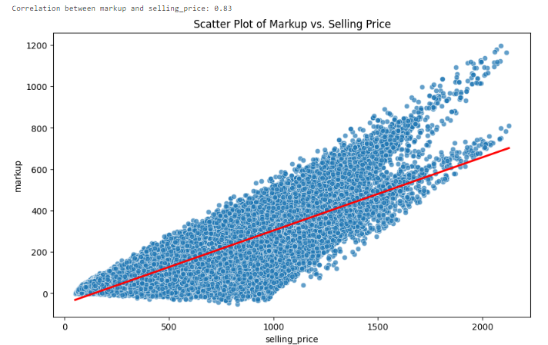
Markup Vs Selling Price Analysis

Slide 18
Observation
The correlation value of 0.83 between markup and selling_price suggests a strong positive correlation. This means that as the markup increases, the selling_price tends to increase as well.
The correlation value of 0.83 between markup and selling price suggests a strong positive correlation.
This means that as the markup increases, the selling price tends to increase as well.

Slide 19
Causes and Strategies
Optimize Markups Based on Demand.
Target Price-Sensitive Segments with Promotions.
Personalized Offers for High-Value Customers.

Slide 20
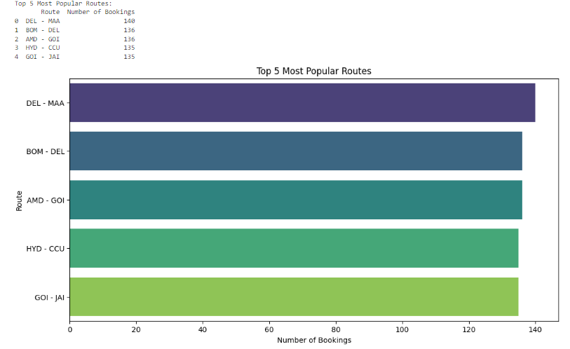
Most Popular Routes

Slide 21
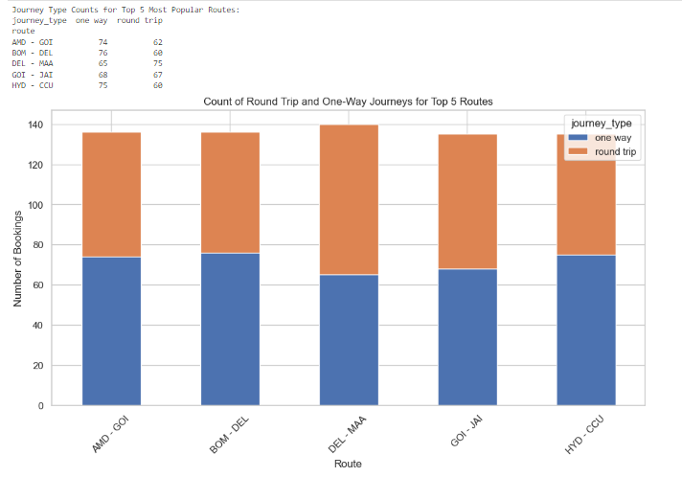
Round Trip and One Way Analysis of Popular Routes

Slide 22
Causes and Strategies
Dynamic Route-Based Pricing
Increase Markups on High-Demand Routes: For popular routes (DEL_MMA,BOM-DEL), where demand is consistently high, increase the markup slightly to maximize revenue. This strategy works well because travelers on popular routes are generally less price-sensitive.
Leverage Ancillary Services for Round-Trips:
Offer Ancillary Products and Services: For round-trip bookings, consider upselling or cross-selling ancillary services such as seat upgrades, extra baggage, in-flight meals, or airport transfers. This can increase the overall revenue per booking.

Slide 23
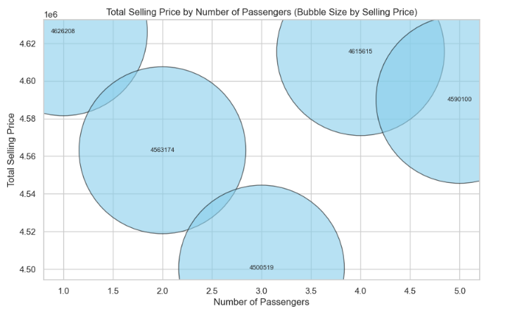
Analysis of No of Passengers Booked(PAX)

Slide 24
Causes and Strategies
Most tickets are booked as a single unit (i.e., individual bookings rather than group bookings).
Implement a Loyalty and Referral Program:
Reward Repeat Bookings: Develop a loyalty program that rewards customers for repeat bookings. Offer points, discounts, or cashback on future purchases to encourage customers to book more frequently.
Referral Incentives: Introduce a referral program where customers earn rewards or discounts for referring friends or family. This can help attract new customers and increase the number of bookings.

Slide 25
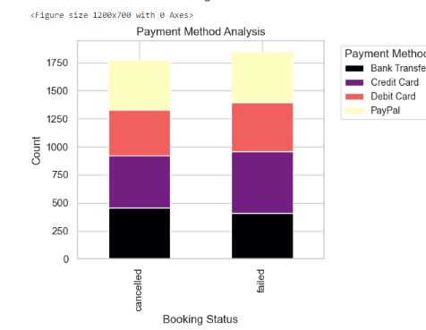
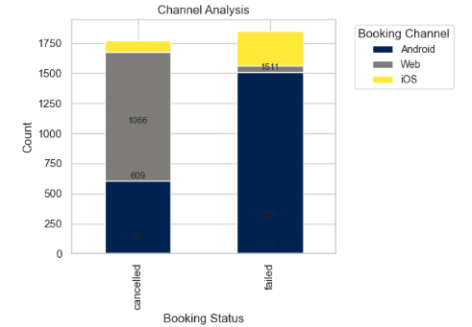
Mode Of Payment Analysis: Cancelled Vs Failed

Slide 26
Observation
Most canceled and failed bookings are associated with specific payment methods (credit card) and booking channels (web portal for cancellations and Android app for failed statuses), this indicates potential issues with the user experience, payment processing, or platform-specific problems.

Slide 27
Causes and Strategies
Payment Method Issues (Credit Card):
Payment Gateway Failures or Errors-The high rate of cancellations and failed bookings associated with credit card payments could indicate issues with the payment gateway, such as timeouts, declines, or technical errors during transaction processing.
Fraud Detection and Security Checks: Overly strict fraud detection mechanisms or additional security checks for credit card payments may lead to genuine transactions being declined, causing customer frustration and cancellations.
Platform-Specific Issues (Web Portal and Android App):A high cancellation rate through the web portal could indicate a poor user experience, such as complex booking flows, unclear cancellation policies, or lack of support for modifying bookings.

Slide 28
Causes and Strategies
Improve Payment Gateway Reliability:
Optimize Payment Gateway Performance: Work with payment gateway providers to optimize the payment process, reducing the likelihood of timeouts, declines, and errors.
Implement Multiple Payment Gateways: Use multiple payment gateways to provide redundancy.

Slide 29


Thank You!!!

